Slide 1
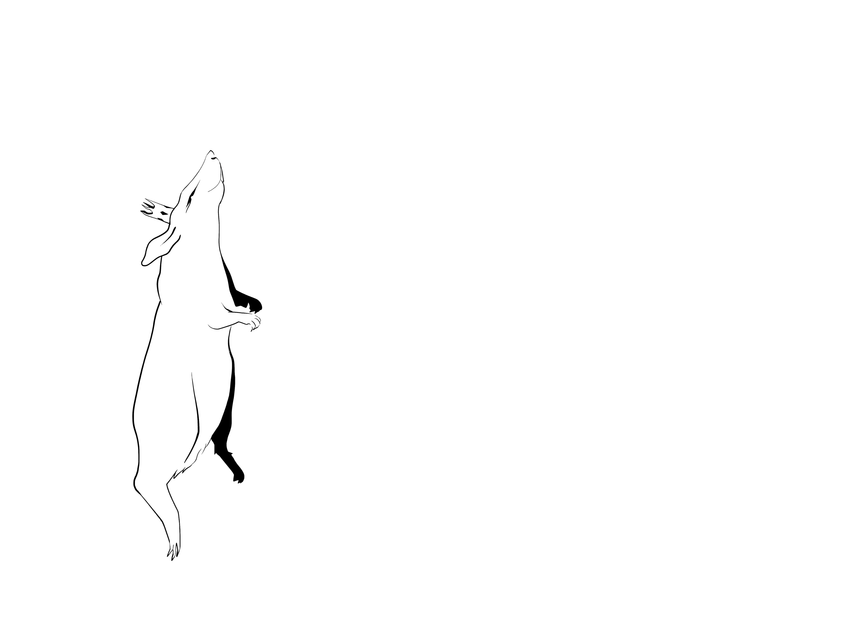

ANATOMY OF A
LAB RAT
1. SNOUT
4. BRAIN
2. EAR
3. GROIN
FOOTNOTES:
G6 – M2; L4 – C8; P7 – O6; O1-A2; J9 – L6; E8 – J9; F4 – J5

